Slide 1

COMPUTER NETWORKS
(BCSC 0008)
Copyright content, use only with the written permission of presenter mentioned
Lecture 21

Slide 2
Text and Reference Books
Text Books:
Fourouzan B. A. (2004), “Data Communication and Networking”, 4th Edition, McGraw-Hill.
References:
Kurose, J. F. and Ross K. W. (2005), “Computer Networking: A Top-Down Approach Featuring the Internet”, 3rd Edition, Addison-Wesley.
A. S. Tanenbaum (2006), “Computer Networks”, 2nd Edition, Prentice Hall India.

Slide 3
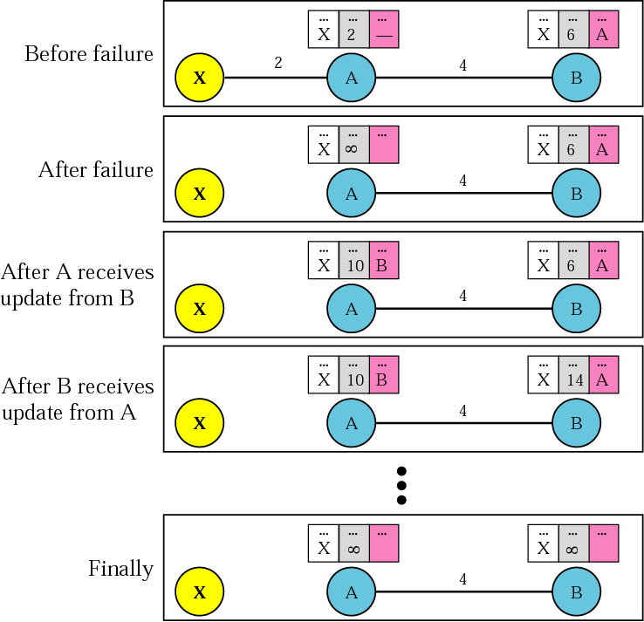
Figure 14.6 Two-node instability – what can happen with distance vector routing
Both A and B know
where X is.
Link between A and X
fails. A updates its
table immediately.
But before A can tell B,
B sends its info to A!
A, using B’s info, up-
dates its table (error!).
Then A send its table
to B and B updates its
table (more error).
Both routers keep up-
dating tables, event-
ually hitting infinity. In
the meantime, chaos!

Slide 4
Figure 14.6 Two-node instability – what can happen with distance vector routing
Possible Solutions to two-node instability:
1. Define infinity to be a much smaller value, such as 100.
Then it doesn’t take too long to become stable. But now
you can’t use distance vector routing in large networks.
2. Split Horizon – instead of flooding entire table to each
node, only part of its table is sent. More precisely, if node
B thinks that the optimum router to reach X is via A, then
B does not need to advertise this piece of info to A – the
info has already come from A.
3. Split Horizon and Poison Reverse – Normally, the distance
vector protocol uses a timer. If there is no news about a
route, the node deletes the route from its table. So when A
never hears from B about the route to X, it deletes it.
Instead, Node B still advertises the value for X, but if the
source of info is A, it replaces the distance with infinity,
saying “Do not use this value; what I know about this route
comes from you.”

Slide 5
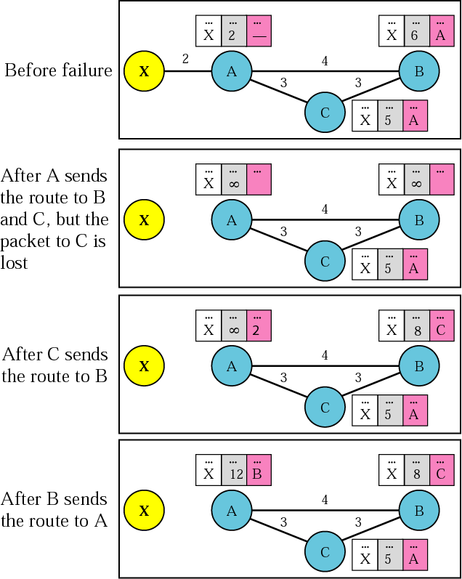
Figure 14.7 Three-node instability – no solutions here!

Slide 6
14.3 RIP
The Routing Information Protocol (RIP) is an intradomain routing protocol used inside an autonomous system. It is a very simple protocol based on distance vector routing.
The topics discussed in this section include:
RIP Message Format
Requests and Responses
Timers in RIP
RIP Version 2
Encapsulation

Slide 7
